Slide 1

Writing Test Plans Made Easy, Workshop
Wayne Roseberry
SDET Manager, Ford Motor Company

Slide 2
Exercise 1: Write the Feature Outline (15 min.)
Review your product
List the Big Parts
one part per line, single words & short phrases
Add Smaller Parts Under Big Parts
Indentation, sub-number, anything that helps
Stop When it Feels Right
Trade With A Partner and Review (YOUR FIRST DELIVERABLE)
Does this look right?
Did I miss something?
Does the organization make sense?
We discuss as a group

Slide 3
Today we will…
I normally start presentations here…
…but the book jumps right into building the outline as well. The point is to get started as simply and quickly as possible.
It is very important that the first exercise produced reviewable deliverables for a previously unseen project in < 15 minutes.
Outline the plan
Identify requirements and test ideas
“You’re not done yet…” – start details
I am teaching you to teach this two-part approach.
Simple outline, fast, reviewable
Short, easy to read test idea details

Slide 4
Outline the Plan
It is a coverage model
Any form – use what you like best
Linear outlines, mind maps, graphs, tables, cartoons, diagrams…
It is reviewable
Single-word statements (usually…)
Hierarchical (Big Parts -> Smaller Parts)
Breadth Over Depth
Like drawing a big circle around everything

Slide 5
Adding Requirements
Just the idea, do not copy
“Tarzan Talk” fine, encouraged
Borrow the outline headings
E.g. an outline titled “Clipboard” might not need the requirement “user can copy and paste”
Look for non-obvious
E.g. the requirement “When a user copies a work item and pastes it into the assignment description, a photo should be included. Elsewhere, it should just be a link” is non-obvious for “Clipboard”

Slide 6
Exercise 2: Add Requirements (15 min.)
Start with prior outline
Add requirements under headings
Trade with someone and review (YOUR SECOND DELIVERABLE!)
We discuss as a group

Slide 7
Adding test ideas
For each requirement, add a test idea
“What might go wrong here?”
“What happens when…”
Test heuristics work well
E.g. “Test the claim that <claim from requirement>”, “Test with different types of data”, “Test with error conditions”
Tailor the heuristic to the requirement, e.g. “Help desk submission workflow with error conditions connecting between backend services”
Heuristic Test Strategy Model https://www.satisfice.com/download/heuristic-test-strategy-model#

Slide 8
Exercise 3: Add Test Ideas (15 min)
Start with existing plan
Pick a requirement and add several test ideas
Swap with someone and review
Do these make sense?
Are there any missing?
Which seem important?
We discuss as a group

Slide 9
Adding Test Idea Details
Reader can imagine the cases
Use models that expand easily
Avoid lists of step-wise cases
Avoid flat lists

Slide 10
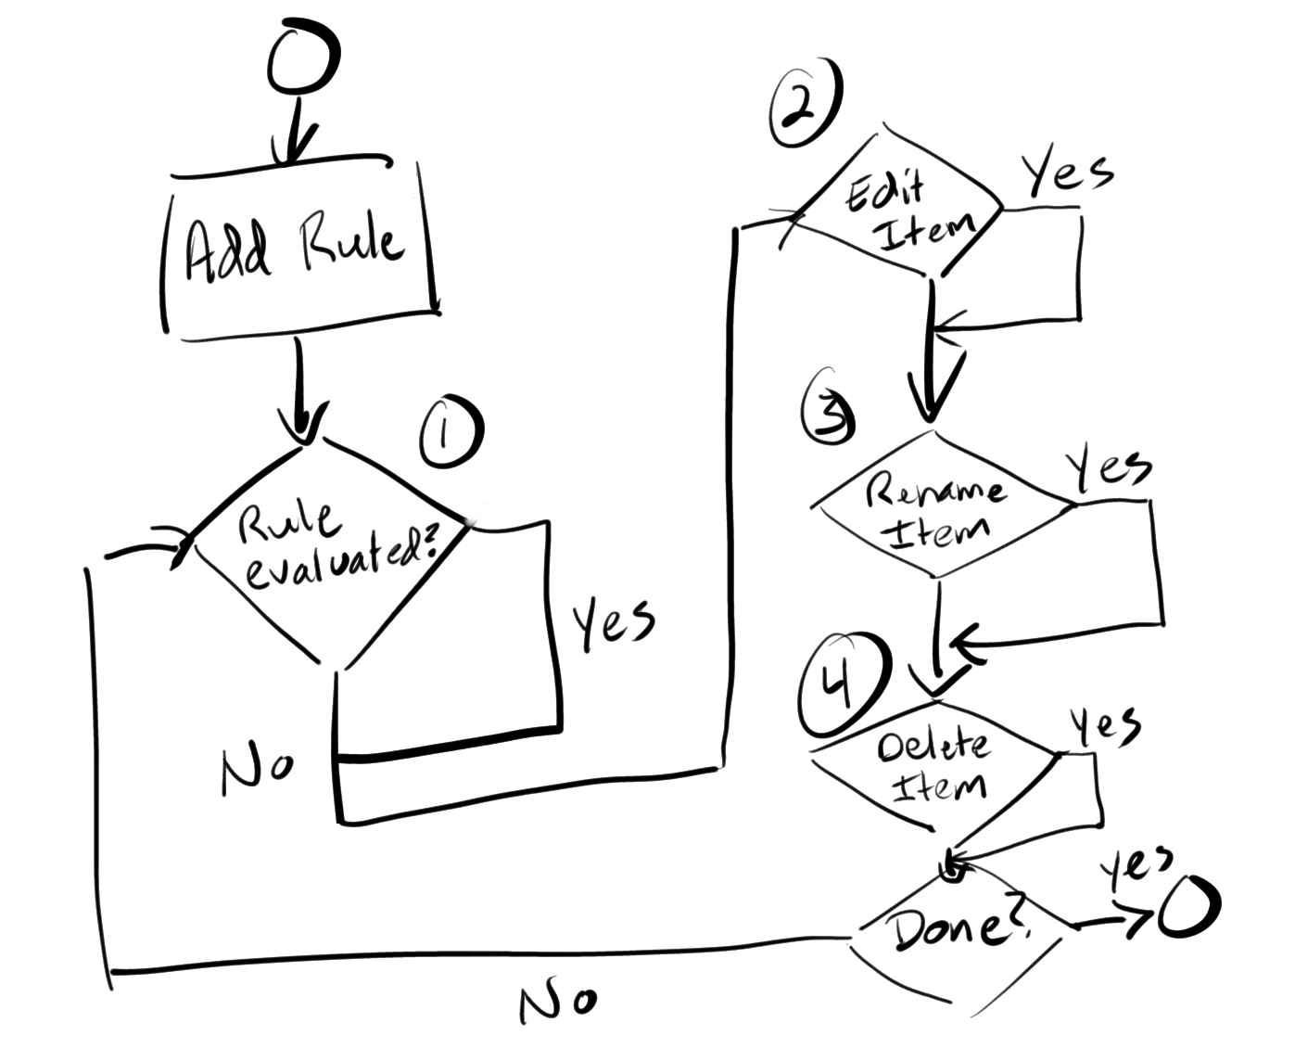
Model examples
Flowchart: Each path through the flow is a new case. This example shows 16 cases without loop on “Done”, 256 if loop once, 2^loops to infinity.
Tables (matrix): combine variables together to create cases. This example is 4x5x4 = 80 cases.
Item_Actions_And_User_Roles
User Role | Action | Item Type
Admin | Route | Page
Author | Remove | List
Publisher | Publish | Ticket
Reader | Revert | Sub-site
 | Edit
Name things to re-use later
Pseudocode: Describe the test approach as if it is code. This example describes a different number of cases based on the word size of the processor.
// Repeat the following for the values MININT to MAXINT
long TestSquareRoot(long start, long end, long interval) {
long x = start;
for(long x=start;x <= end; x = x + interval) {
If (sqrt(x) * sqrt(x) != x) { LogFail(“sqrt(x) at value “ + x + ”failed with” +sqrt(x)); }
Else { LogPass(“sqrt(x) at value “ + x + “ passed with ” + sqrt(x)); } } }

Slide 11
Exercise 4: Add Test Idea Details (15 min)
Start with existing plan
Pick one test idea and add details
Model the cases instead of list them
Swap with someone and review
Do these make sense?
Are there any missing?
Which seem important?
We discuss as a group

Slide 12
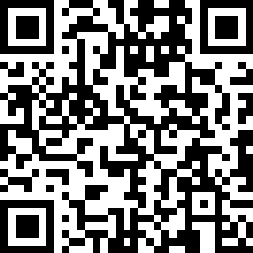
https://www.amazon.com/Writing-Test-Plans-Made-Easy/dp/1478333693

Slide 13


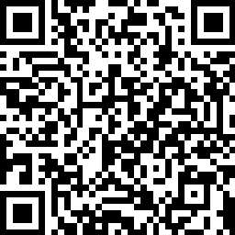
Drawn to Testing series
Articles and cartoons about testing, test management, test strategy, test automation, AI in testing.
https://www.amazon.com/dp/B0GCZXQ5TN?binding=paperback&qid=1768750492

